Slide 1
Project Title: Image Caption Generation with Computer Vision, NLP and High Performance Computing
Name: AHASAN HABIB
ID: 24141256
Date: 7th September, 2025
Objective: To automatically generate descriptive captions for images using a neural network.

Slide 2
Problem & Motivation
The Challenge: How can a computer "see" an image and describe its content in natural language?
Motivation:
Accessibility for visually impaired users.
Efficiently organizing and searching large image databases.
Automating social media content creation.
Advancing general AI capabilities in computer vision and natural language processing.

Slide 3
The Approach - A Two-Part System
Part 1: Feature Extraction
Goal: To convert an image into a numerical representation (a feature vector).
Tool: A pre-trained VGG16 model (from ImageNet).
Process: The model "looks" at the image and extracts high-level features like shapes, textures, and objects. The output is a 4096-dimensional vector.
Part 2: Caption Generation
Goal: To translate the feature vector into a human-readable sentence.
Tool: A Recurrent Neural Network (RNN), specifically an LSTM (Long Short-Term Memory).
Process: The LSTM takes the image feature vector and generates a caption word by word, learning the grammatical structure and context from the captions in the training data.

Slide 4
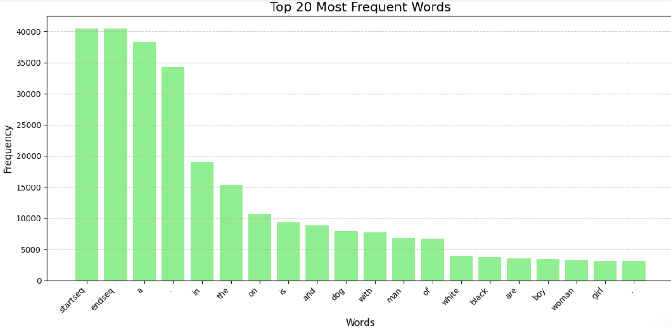
Data & Preprocessing
Dataset: Flickr 8k
Dataset:
Contains 8,092 images.
Each image has 5 human-written captions.
Preprocessing:
Captions were cleaned and standardized.
Special tokens (<startseq> and <endseq>) were added to mark the beginning and end of each caption, helping the model know when to start and stop generating.
The captions were tokenized and mapped to unique numeric IDs.

Slide 5
Model
Architecture
Input 1 (Image Features): A 4096-dimensional vector from VGG16.
Input 2 (Text Sequence): The caption sequence up to the current word.
Embedding Layer: Converts the word IDs into dense vectors.
LSTM Layer: Processes the caption sequence, capturing the sequential dependencies.
Dropout Layers: Prevents overfitting.
Dense Layers: A final layer to predict the next word in the sequence.
Model Training:
Epochs: 20
Optimizer: Adam
Loss Function: Categorical Cross-entropy

Slide 6
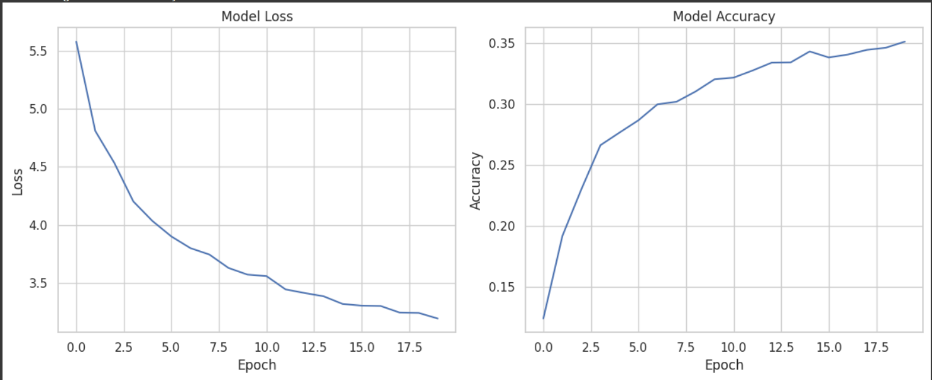
Results - Training Performance
Model Loss: A measure of how wrong the model's predictions are. My model's loss decreased over time.
Model Accuracy: A measure of how often the model predicts the correct next word. My accuracy increased over the training period.

Slide 7
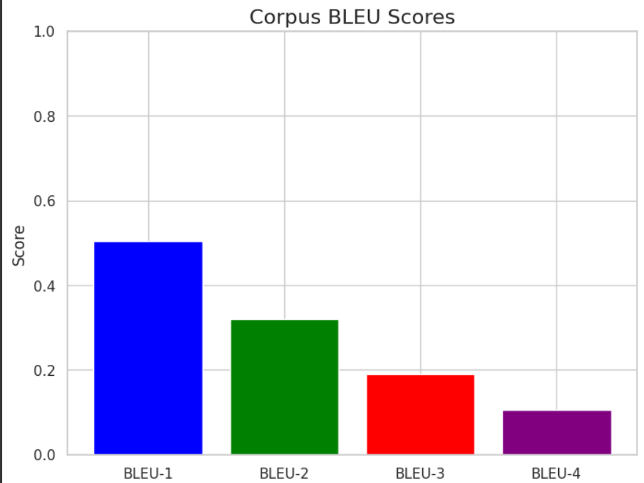
Results - Evaluation
BLEU Scores: The standard metric for evaluating text generation models. It compares the generated captions to the human-written reference captions.
BLEU-1: 0.5032
BLEU-2: 0.3195
BLEU-3: 0.1898
BLEU-4: 0.1052

Slide 8
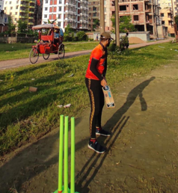

Live Demonstration
Objective: To show the model in action.
Process:
A new image is provided to the model.
The VGG16 model extracts its features.
The LSTM generates a caption, word by word.
Example:
Generated Caption: "man in a red shirt is standing on a road"
Discussion: The model correctly identifies the person, clothing, and location, showcasing its ability to generate a plausible caption.

Slide 9
Conclusion & Future Work
Summary:
I successfully built a model that can generate captions for images.
The model effectively combines computer vision and natural language processing.
Potential Improvements:
Use a more advanced feature extractor (e.g., ResNet).
Fine-tune the pre-trained feature extractor on the target dataset.
Train on a larger dataset (e.g., MS COCO).
Experiment with different model architectures or attention mechanisms.

Slide 10
Q&A
Thank you for your time!
Questions?

